Slide 1
All We do is Wynn!
2025 Wynn Family Reunion
Detroit, Michigan

Slide 2
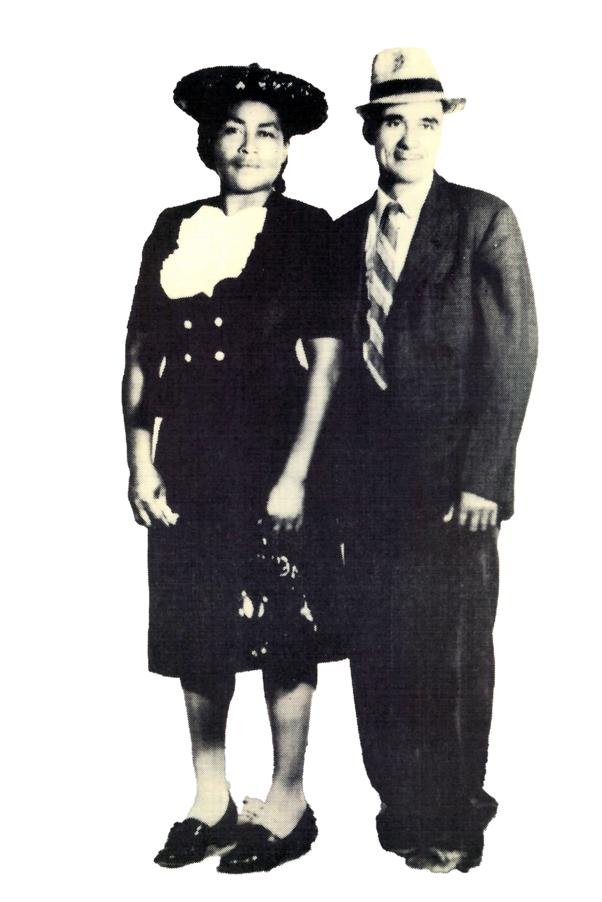
Owen and Sarah Wynn
Is where it all began in Bessemer Alabama:
Raised 14 children, sending many to college or other institutes of skilled training
Several grandchildren spent their early lives with them as parents prepared for a better life
Purchased multiple properties on the hill of 3rd Avenue

Slide 3
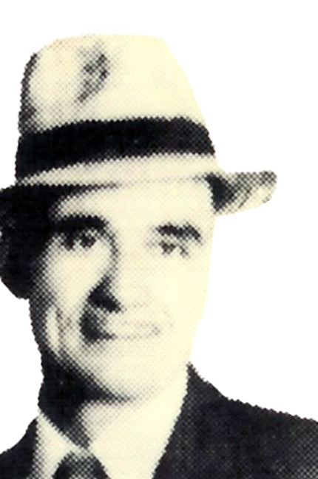
Owen Wynn, sr.
Born July 4, 1886 in Green County, Alabama
Parents: Sarah Smith and Thomas (Tom All) Wynn
Worked in the Iron Ore Mines of Bessmer, Alabama for 51 years;
Santa Rita Mines
Sloss Mines
Raimund Mines
Deacon of Mt. Sinai Baptist Church

Slide 4
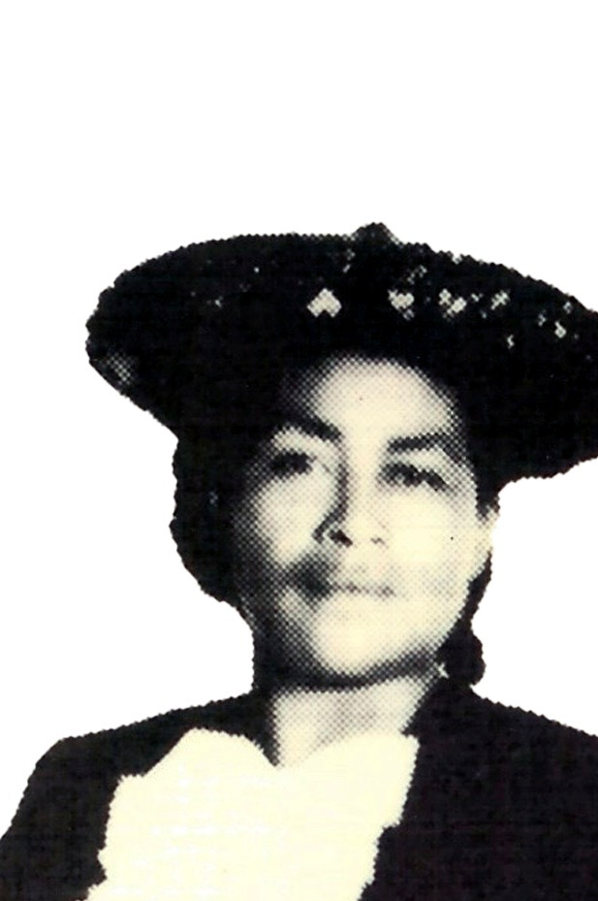
Sarah Smith Wynn
Born August 5, 1895 in Utah, Alabama
Parents: Margie Oliver Frederick Smith and Robert Smith (Papa Lane)
One of Papa Lane’s parent was Native American from the Choctaw tribe
Five brothers: Alcorn, Page, Richmond, Bigum and one more
Four sisters: Nooga, Mary (Nooga), Mennie (Honey) and one more
Head of domestic house hold
Entrepreneur: Rasing and selling crops

Slide 5
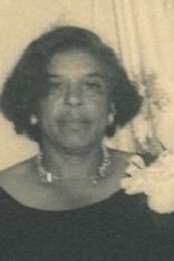
Minnie Wynn Evans Sibling #1
Date of Birth: March 3, 1900
Mother: Sarah Beverly
Place of Birth: Hale County
High School Attended: First grade
Education/Training: None
Career: Supported Grandma Wynn with her siblings
Spouse: Taylor Evans
Children: Calvin (Nick)

Slide 6
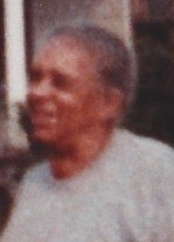
Minnie Wynn Evans Sibling #1
Date of Birth: March 3, 1900
Mother: Sarah Beverly
Place of Birth: Hale County
High School Attended: First grade
Education/Training: None
Career: Supported Grandma Wynn with her siblings
Spouse: Taylor Evans
Children: Calvin (Nick)

Slide 7
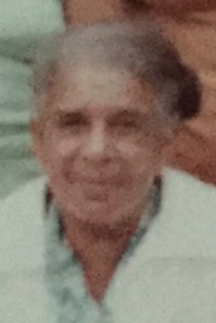
Minnie Wynn Evans Sibling #1
Date of Birth: March 3, 1900
Mother: Sarah Beverly
Place of Birth: Hale County
High School Attended: First grade
Education/Training: None
Career: Supported Grandma Wynn with her siblings
Spouse: Taylor Evans
Children: Calvin (Nick)

Slide 8
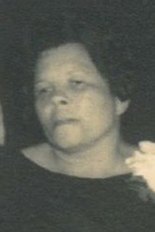
Inez Wynn Wilson Sibling #2
Date of birth: August 15, 1910
Place of birth: Jefferson County, Alabama
High School Attended: ?
Education/Career:
Spouse: Wilson
Children: Owen Alford (Sweets), Claude, Gwen, Arnette, Wilma, Sonya Faye, Bennie Ruth

Slide 9
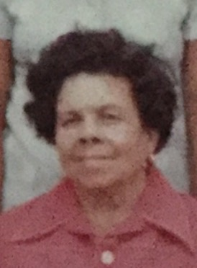
Inez Wynn Wilson Sibling #2
Date of birth: August 15, 1910
Place of birth: Jefferson County, Alabama
High School Attended: ?
Education/Career:
Spouse: Wilson
Children: Owen Alford (Sweets), Claude, Gwen, Arnette, Wilma, Sonya Faye, Bennie Ruth

Slide 10
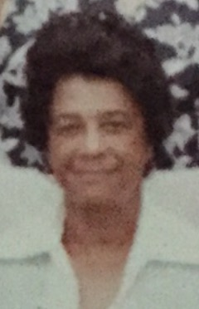
Lizzie Mae Wynn Adams Sibling #3
Date of Birth: June 20, 1912
Place of Birth: ?
High School Attended:
Education/Training:
Career: Elevator and Customer Service, Loveman’s Department Store
Spouse: Webster Adams
Children: None

Slide 11
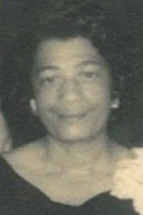
Lizzie Mae Wynn Adams Sibling #3
Date of Birth: June 20, 1912
Place of Birth: ?
High School Attended:
Education/Training:
Career: Elevator and Customer Service, Loveman’s Department Store
Spouse: Webster Adams
Children: None

Slide 12
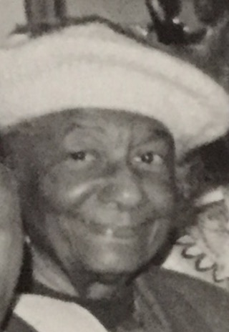
Lizzie Mae Wynn Adams Sibling #3
Date of Birth: June 20, 1912
Place of Birth: ?
High School Attended:
Education/Training:
Career: Elevator and Customer Service, Loveman’s Department Store
Spouse: Webster Adams
Children: None

Slide 13
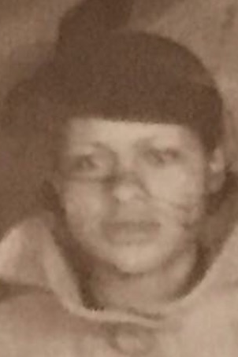
Margie Lee Wynn Caver (Brown) Sibling #4
Date of Birth: January 26, 1914
Place of Birth: Bessemer
High School Attended: Spellman, Fort Valley High School
Education/Training: Spellman and Alabama State University
Career: Elementary Educator
Spouses: Shernam, Richard, Mr. Caver, Jimmy Brown
Children: Raised Gwen Brooks (Sanders)

Slide 14
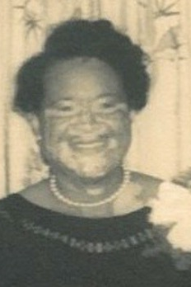
Margie Lee Wynn Caver (Brown) Sibling #4
Date of Birth: January 26, 1914
Place of Birth: Bessemer
High School Attended: Spellman, Fort Valley High School
Education/Training: Spellman and Alabama State University
Career: Elementary Educator
Spouses: Shernam, Richard, Mr. Caver, Jimmy Brown
Children: Raised Gwen Brooks (Sanders)

Slide 15
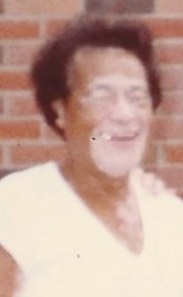
Margie Lee Wynn Caver (Brown) Sibling #4
Date of Birth: January 26, 1914
Place of Birth: Bessemer
High School Attended: Spellman, Fort Valley High School
Education/Training: Spellman and Alabama State University
Career: Elementary Educator
Spouses: Shernam, Richard, Mr. Caver, Jimmy Brown
Children: Raised Gwen Brooks (Sanders)

Slide 16
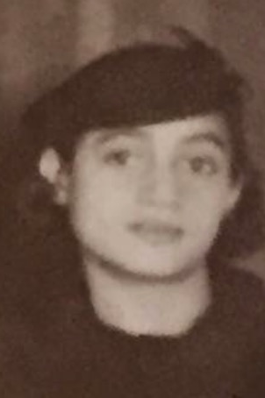
Ennis James Wynn Burney Sibling #5
Date of Birth: February 16, 1916
Place of Birth: Bessemer
High School Attended: Fort Valley
Education/Training: Fort Valley State College (Homecoming)
Career: Educator
Spouse: Robert Burney
Children: Jackie, Barbara, Robert, Carol, Roger, George, Donald

Slide 17
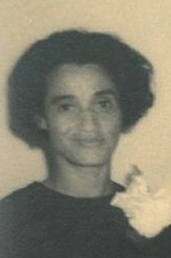
Ennis James Wynn Burney Sibling #5
Date of Birth: February 16, 1916
Place of Birth: Bessemer
High School Attended: Fort Valley
Education/Training: Fort Valley State College (Homecoming)
Career: Educator
Spouse: Robert Burney
Children: Jackie, Barbara, Robert, Carol, Roger, George, Donald

Slide 18
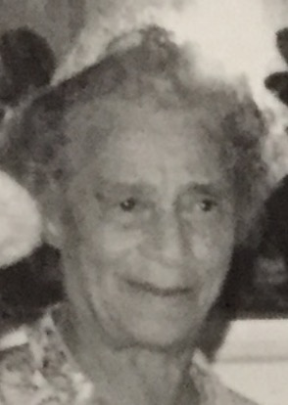
Ennis James Wynn Burney Sibling #5
Date of Birth: February 16, 1916
Place of Birth: Bessemer
High School Attended: Fort Valley
Education/Training: Fort Valley State College (Homecoming)
Career: Educator
Spouse: Robert Burney
Children: Jackie, Barbara, Robert, Carol, Roger, George, Donald

Slide 19
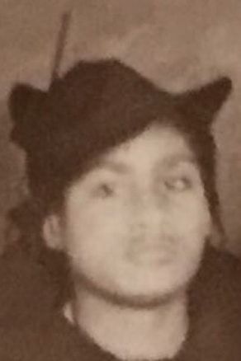
Beatrice Wynn Brooks Sibling #6
Date of Birth: November 14, 1917
Place of Birth: Bessemer
High School Attended: Saint Mark in Ensley
Education/Training: Miles College
Career: School teacher in Atmore AL
Spouse: Eddie Brooks
Children: Wilma Wilson

Slide 20
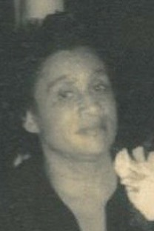
Beatrice Wynn Brooks Sibling #6
Date of Birth: November 14, 1917
Place of Birth: Bessemer
High School Attended: Saint Mark in Ensley
Education/Training: Miles College
Career: School teacher in Atmore AL
Spouse: Eddie Brooks
Children: Wilma Wilson

Slide 21
Beatrice Wynn Brooks Sibling #6
Date of Birth: November 14, 1917
Place of Birth: Bessemer
High School Attended: Saint Mark in Ensley
Education/Training: Miles College
Career: School teacher in Atmore AL
Spouse: Eddie Brooks
Children: Wilma Wilson

Slide 22
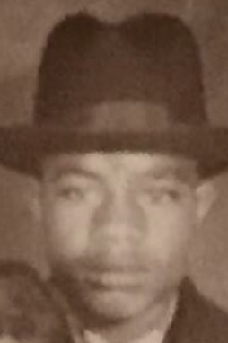
Owen Wynn, Jr. Sibling #7
Date of Birth: September 11, 1919
Place of Birth: Bessemer
High School Attended: Dunbar High School
Education/Training: Armed Services and Skill Tradesman (Nelmor Company)
Career: Mold Steel Manufacturer; Nelmor Company
Spouse: Bertha Norman
Children: Lois, Barbara, Owen III, Winifred, Dennis & Denise, Dwayne, Rosalind, Harvey

Slide 23
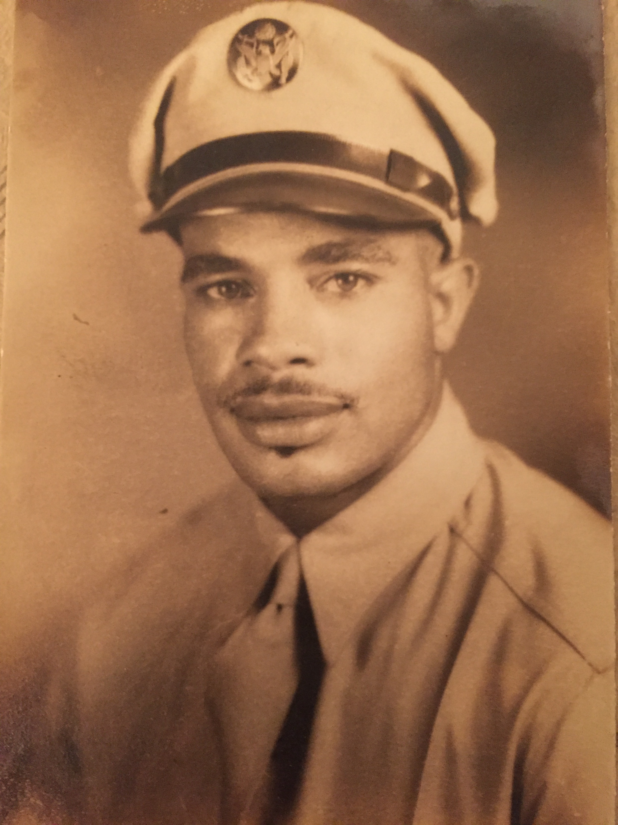
Owen Wynn, Jr. Sibling #7
Date of Birth: September 11, 1919
Place of Birth: Bessemer
High School Attended: Dunbar High School
Education/Training: Armed Services and Skill Tradesman (Nelmor Company)
Career: Mold Steel Manufacturer; Nelmor Company
Spouse: Bertha Norman
Children: Lois, Barbara, Owen III, Winifred, Dennis & Denise, Dwayne, Rosalind, Harvey

Slide 24
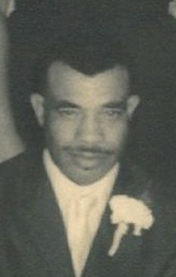
Owen Wynn, Jr. Sibling #7
Date of Birth: September 11, 1919
Place of Birth: Bessemer
High School Attended: Dunbar High School
Education/Training: Armed Services and Skill Tradesman (Nelmor Company)
Career: Mold Steel Manufacturer; Nelmor Company
Spouse: Bertha Norman
Children: Lois, Barbara, Owen III, Winifred, Dennis & Denise, Dwayne, Rosalind, Harvey

Slide 25
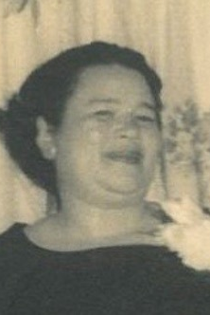
Helen Wynn Dalton Sibling #8
Date of Birth: September 23, 1921
Place of Birth: Bessemer
High School Attended: ???
Education/Training: ???
Career: Cosmetologist (Hair Dresser) and entrepreneur (owned beauty shop)
Spouse: Quentin Dalton
Children: Raised Sonya Faye Wilson

Slide 26
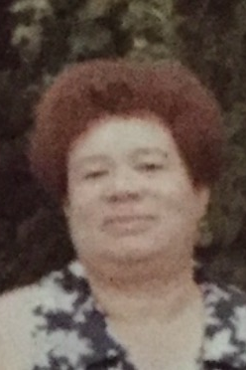
Helen Wynn Dalton Sibling #8
Date of Birth: September 23, 1921
Place of Birth: Bessemer
High School Attended: ???
Education/Training: ???
Career: Cosmetologist (Hair Dresser) and entrepreneur (owned beauty shop)
Spouse: Quentin Dalton
Children: Raised Sonya Faye Wilson

Slide 27
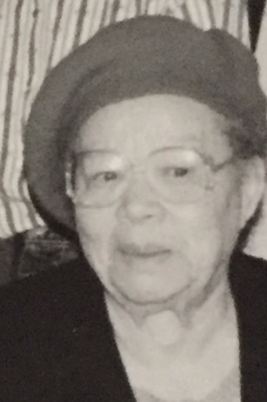
Helen Wynn Dalton Sibling #8
Date of Birth: September 23, 1921
Place of Birth: Bessemer
High School Attended: ???
Education/Training: ???
Career: Cosmetologist (Hair Dresser) and entrepreneur (owned beauty shop)
Spouse: Quentin Dalton
Children: Raised Sonya Faye Wilson

Slide 28
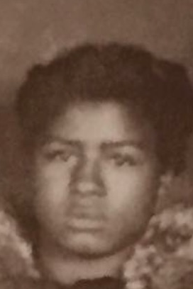
Odessa Doris Wynn Brown Sibling #9
Date of Birth: September 2, 1923
Place of Birth: Bessemer
High School Attended: Dunbar High School
Education/Training: Attended Wayne State University, University of Detroit, Certified Cosmetologist
Spouse: Peter Brown
Career: Chef: Authentic German Cuisine
Spouse: Peter Brown
Children: Bertha Dean, Hayward, Sarah, Alison, Charlotte

Slide 29
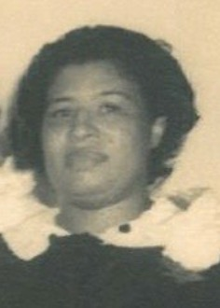
Odessa Doris Wynn Brown Sibling #9
Date of Birth: September 2, 1923
Place of Birth: Bessemer
High School Attended: Dunbar High School
Education/Training: Attended Wayne State University, University of Detroit, Certified Cosmetologist
Spouse: Peter Brown
Career: Chef: Authentic German Cuisine
Spouse: Peter Brown
Children: Bertha Dean, Hayward, Sarah, Alison, Charlotte

Slide 30
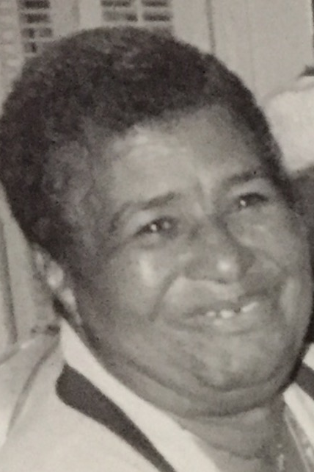
Odessa Doris Wynn Brown Sibling #9
Date of Birth: September 2, 1923
Place of Birth: Bessemer
High School Attended: Dunbar High School
Education/Training: Attended Wayne State University, University of Detroit, Certified Cosmetologist
Spouse: Peter Brown
Career: Chef: Authentic German Cuisine
Spouse: Peter Brown
Children: Bertha Dean, Hayward, Sarah, Alison, Charlotte

Slide 31
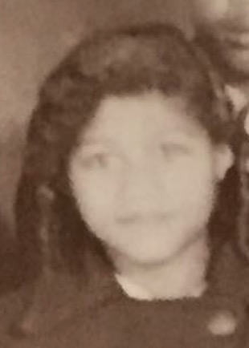
Mildred Wynn Varner Sibling #10
Date of Birth: December 7, 1925
Place of Birth: Bessemer
High School Attended: Dunbar High School
Education/Training: BS Secondary Education, State Teachers College (Alabama State University); MA, University of Montevallo
Career: Physical Education Teacher and Coach
Spouse: Albert Varner
Children: Albert III, Margie, and LaVada (Dian)

Slide 32
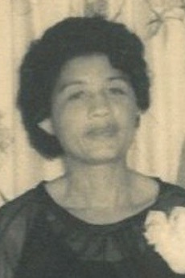
Mildred Wynn Varner Sibling #10
Date of Birth: December 7, 1925
Place of Birth: Bessemer
High School Attended: Dunbar High School
Education/Training: BS Secondary Education, State Teachers College (Alabama State University); MA, University of Montevallo
Career: Physical Education Teacher and Coach
Spouse: Albert Varner
Children: Albert III, Margie, and LaVada (Dian)

Slide 33
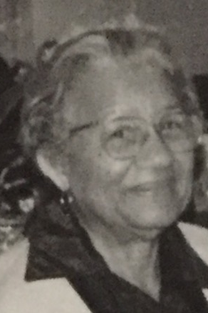
Mildred Wynn Varner Sibling #10
Date of Birth: December 7, 1925
Place of Birth: Bessemer
High School Attended: Dunbar High School
Education/Training: BS Secondary Education, State Teachers College (Alabama State University); MA, University of Montevallo
Career: Physical Education Teacher and Coach
Spouse: Albert Varner
Children: Albert III, Margie, and LaVada (Dian)

Slide 34
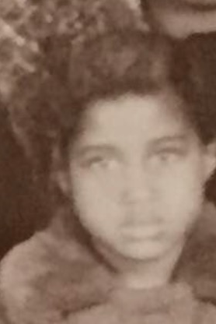
Dorothy Wynn (Boyd) Clore Sibling #11
Date of Birth: October 27, 1927
Place of Birth: Bessemer, AL
High School Attended: Dunbar High School
Education/Training: Tuskegee Institute, Wayne State University, BA and MA
Career: Physical Education teacher and administrator
Spouse(s): John Boyd, Sr. & Siegel Clore
Children: Owen Darnell, John Jr., Melba, Sandy, Dotty and Siegel III

Slide 35
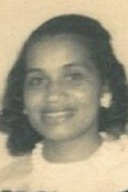
Dorothy Wynn (Boyd) Clore Sibling #11
Date of Birth: October 27, 1927
Place of Birth: Bessemer, AL
High School Attended: Dunbar High School
Education/Training: Tuskegee Institute, Wayne State University, BA and MA
Career: Physical Education teacher and administrator
Spouse(s): John Boyd, Sr. & Siegel Clore
Children: Owen Darnell, John Jr., Melba, Sandy, Dotty and Siegel III

Slide 36
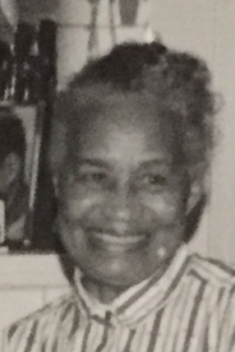
Dorothy Wynn (Boyd) Clore Sibling #11
Date of Birth: October 27, 1927
Place of Birth: Bessemer, AL
High School Attended: Dunbar High School
Education/Training: Tuskegee Institute, Wayne State University, BA and MA
Career: Physical Education teacher and administrator
Spouse(s): John Boyd, Sr. & Siegel Clore
Children: Owen Darnell, John Jr., Melba, Sandy, Dotty and Siegel III

Slide 37
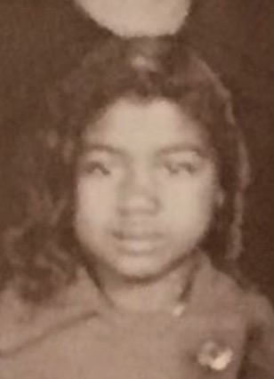
Sarah Ann Wynn Smith Sibling #12
Date of Birth: January 6, 1929
Place of Birth: Bessemer
High School Attended: St. Francis High School
Education/Training: Grady School of Nursing
Career: Head Nurse at Grady Hospital
Spouse: Harry Smith
Children: Gregory, Anthony (Tony), Valerie, Harriet, Rosario (Tasha), Harry LeBaron (Ronnie)

Slide 38
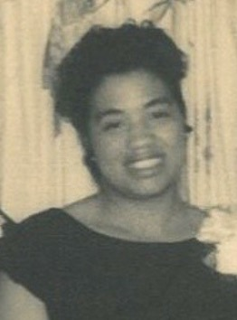
Sarah Ann Wynn Smith Sibling #12
Date of Birth: January 6, 1929
Place of Birth: Bessemer
High School Attended: St. Francis High School
Education/Training: Grady School of Nursing
Career: Head Nurse at Grady Hospital
Spouse: Harry Smith
Children: Gregory, Anthony (Tony), Valerie, Harriet, Rosario (Tasha), Harry LeBaron (Ronnie)

Slide 39
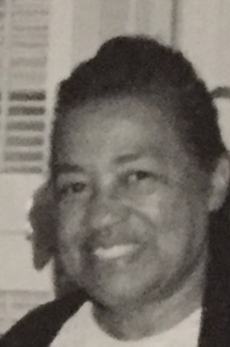
Sarah Ann Wynn Smith Sibling #12
Date of Birth: January 6, 1929
Place of Birth: Bessemer
High School Attended: St. Francis High School
Education/Training: Grady School of Nursing
Career: Head Nurse at Grady Hospital
Spouse: Harry Smith
Children: Gregory, Anthony (Tony), Valerie, Harriet, Rosario (Tasha), Harry LeBaron (Ronnie)

Slide 40
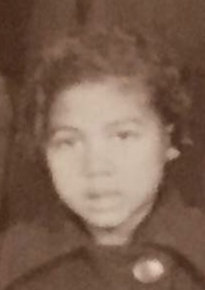
Marion Wynn Sessor Sibling #13
Date of Birth: December 17, 1931
Place of Birth: Bessemer
High School: Dunbar High School
Education/Training: Alabama State, Grady School of Nursing
Career: Nurse
Spouse: James Sessor
Children: James Ricardo, Andre Raymon, Janice, Quentin, Edna Jean

Slide 41
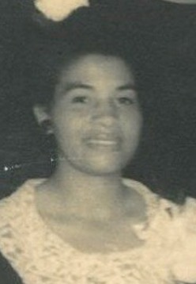
Marion Wynn Sessor Sibling #13
Date of Birth: December 17, 1931
Place of Birth: Bessemer
High School: Dunbar High School
Education/Training: Alabama State, Grady School of Nursing
Career: Nurse
Spouse: James Sessor
Children: James Ricardo, Andre Raymon, Janice, Quentin, Edna Jean

Slide 42
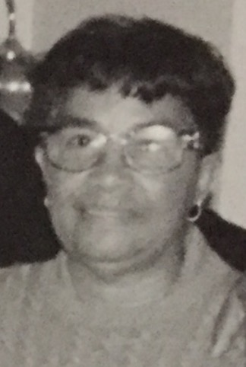
Marion Wynn Sessor Sibling #13
Date of Birth: December 17, 1931
Place of Birth: Bessemer
High School: Dunbar High School
Education/Training: Alabama State, Grady School of Nursing
Career: Nurse
Spouse: James Sessor
Children: James Ricardo, Andre Raymon, Janice, Quentin, Edna Jean

Slide 43
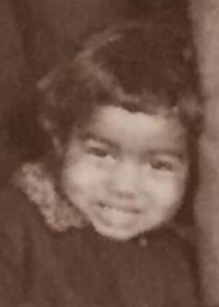
Edna Jean Wynn Woodard Sibling #14
Date of Birth: October 2, 1934
Place of Birth: Bessemer
High School Attended: Dunbar HS
Education/Training: BA Knoxville College; MA Montevallo College
Career: Physical Education Educator
Spouse: Wogan Woodard Sr.
Children: Jeffery and Wogan Jr.

Slide 44
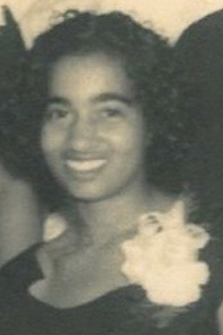
Edna Jean Wynn Woodard Sibling #14
Date of Birth: October 2, 1934
Place of Birth: Bessemer
High School Attended: Dunbar HS
Education/Training: BA Knoxville College; MA Montevallo College
Career: Physical Education Educator
Spouse: Wogan Woodard Sr.
Children: Jeffery and Wogan Jr.

Slide 45
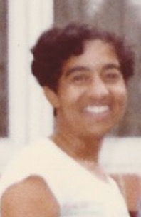
Edna Jean Wynn Woodard Sibling #14
Date of Birth: October 2, 1934
Place of Birth: Bessemer
High School Attended: Dunbar HS
Education/Training: BA Knoxville College; MA Montevallo College
Career: Physical Education Educator
Spouse: Wogan Woodard Sr.
Children: Jeffery and Wogan Jr.

Slide 46
The 15th Sibling

Slide 47
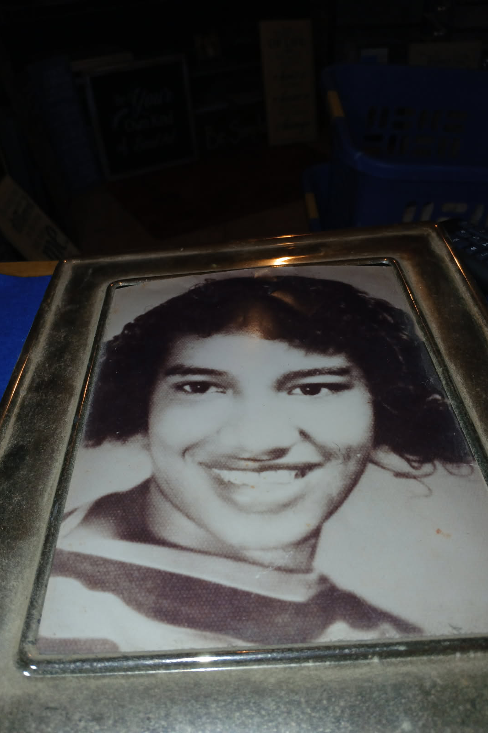
Lois wynn
Date of Birth: June 13, 1938
Place of Birth: Bessemer
Mother: Lindsay
High School Attended: Dunbar High School
Education/Training: Carver Vocational Tech
Career: Nurse at Grady Hospital
Spouse: None
Children: Damn near all the Wynns, especially the Georgia Smiths

